Slide 1
IMPLEMENTING MEDIUM-TERM RESULTS BASED BUDGETING in
Central Government
The Road to Performance-Oriented Budgeting
August 20, 2019
Marcia Faulknor

Slide 2
OUTLINE
Context/background
Overview - MTRBB
Integrating Planning and Budgeting
Rationalized Programme Structure
Performance Management
Next Steps

Slide 3
Medium Term Results Based Budgeting
Context for Change
  Comprehensive reform of Public Financial Management (PFM) in progress
    Good PFM system: Strategic allocation resources, credible fiscal strategy /budget, accuracy /comprehensiveness in reporting, transparency/accountability, efficient and effective service delivery
    Recommendations based on weaknesses (AuG, IMF, PEFA, etc.): budget formulation/execution, cash, debt, payroll, pension, procurement mgt, etc.
  Strategic direction/decision – target areas where weaknesses were identified
    Management of Cash Resources: CTMS/IFMIS, ICT Systems: Jamaica Customs, Tax Admin., roll out of Govt Electronic Procurement System, Public Sector Employee Pension Admin System , etc.
    Improving way budgets are prepared, consistent with international best practices, principles in performance and policy based budgeting
      MTRBB – international leading practice
      Process commenced 2015/16: budget cycle, MTRBB (phased), Final set of MDAs. Assistance of Consultants
Why Medium Term Results Based Budgeting (MTRBB)?
  Harmonized or linked policy, planning ,resource allocation of Govt /MDAs with budget process
  Integrate the budget into performance management/ accountability system of Govt
  Shifts budget process to medium term: allows for future cost of existing programmes/projects - reflected in ‘Forward Years’
Notes:
PEFA – Public Expenditure Financial Accountability review. CTMS – Central Treasury Management Sys. IFMIS- Integrated Financial Information Management System

Slide 4
What is MTRBB?
MTRBB - Medium-Term Results Based Budgeting
MTRBB - type of performance-based budgeting methodology or approach for budget preparation and implementation in which available resources are allocated based on government’s policy objectives, and not to administrative units
MTRBB - budgeting for and reporting on public expenditure by programmes, while taking into account the performance of the programmes and associated public sector institutions/MDAs, given allocations.
In this way, MTRBB improves effectiveness and efficiency of public expenditure.

Slide 5
The Essence of MTRBB
Enabling Government to effectively allocate scarce resources to priority objectives
Establishing/ensuring strong links between medium-term policy planning and budgeting
Facilitate better Government-wide accountability for policy performance
Efficient Service Delivery/Value for money, Proper management of resources
Fiscal discipline, effective control budget/management of fiscal risks
In short, Programme classification will be the basis for policy decisions and resource allocations
Why? It will be easier for both policymakers and the public to see for what purposes the funds are being used.

Slide 6
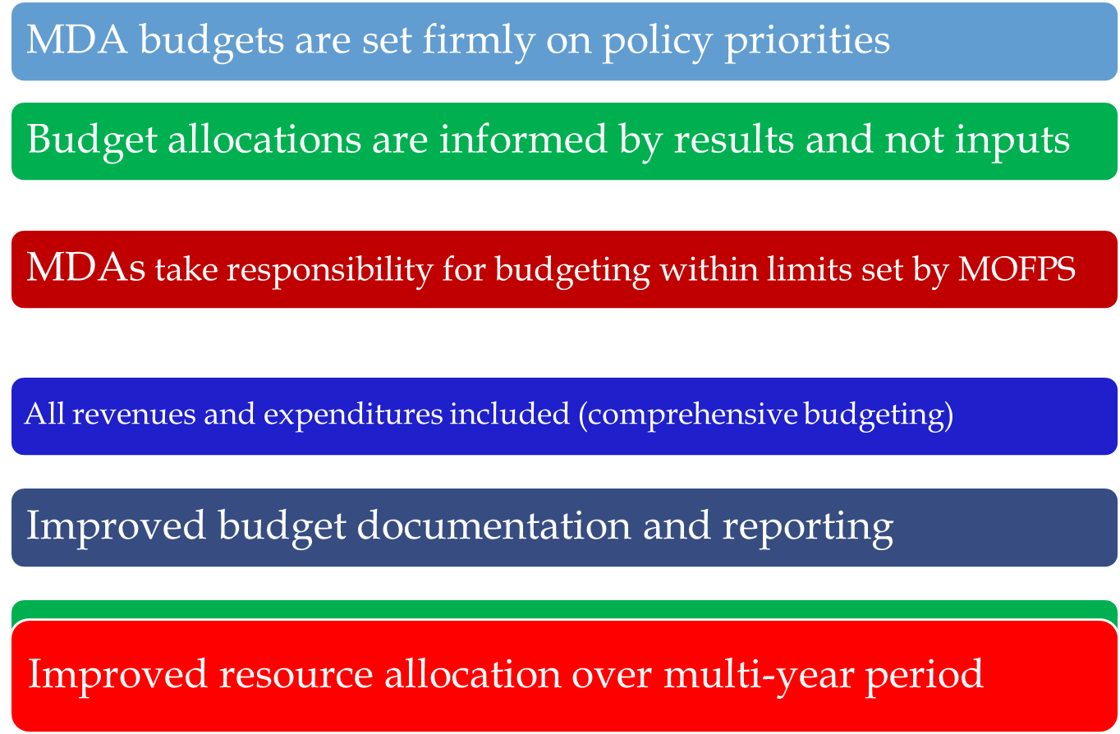
How will the MTRBB Reform Benefit the GOJ?

Slide 7
How will the MTRBB Reform Benefit the MDAs?
Enables MDAs to develop core rational budget proposal leading to more sensible budget decisions
Gives MDA programme managers a tool to gauge how well their programmes are performing
Provides managers with better capabilities to move resources from ineffective programmes to more effective programmes
Allows for better budget planning in order to allocate resources to areas of greatest need
Improves customer service and stimulates a sharper focus on citizens’ needs
Ministries - better able to execute budgets without interference
Help ministries use the resources they have more wisely

Slide 8
Integrating Planning and Budgeting Process
One of the aims of the MTRBB - to integrate and align the planning and budgeting process.
  Allows for formulation a results chain framework - mapping of MDA budget programmes to strategic priorities and Whole of Government Framework
    a set of 8 medium-term focus areas (government strategic priorities), which are themselves aligned to the Medium-Term Socio-Economic Policy Framework (MTF), the 15 national outcomes and 4 national goals reflected in Vision 2030.

Slide 9
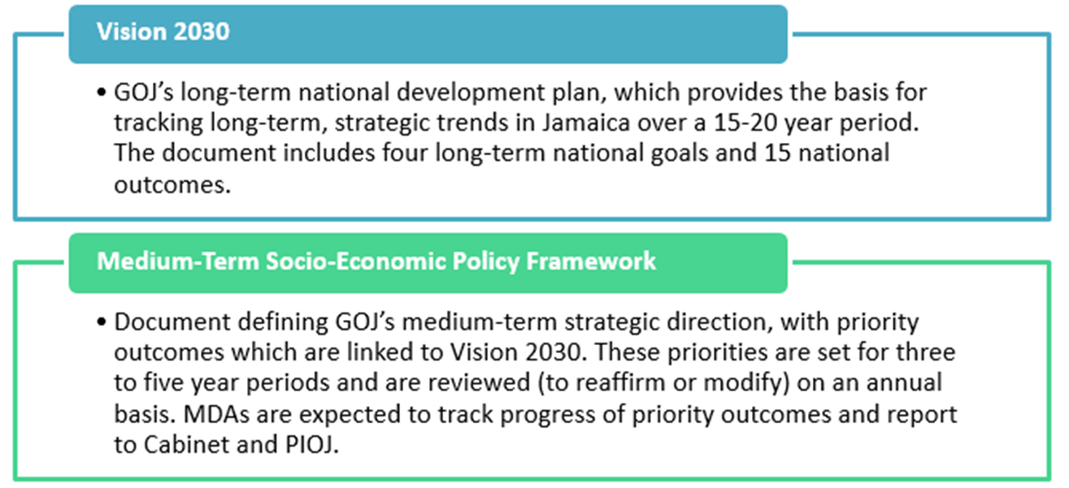
Performance Monitoring and Evaluation and Whole of Gov’t Framework

Slide 10
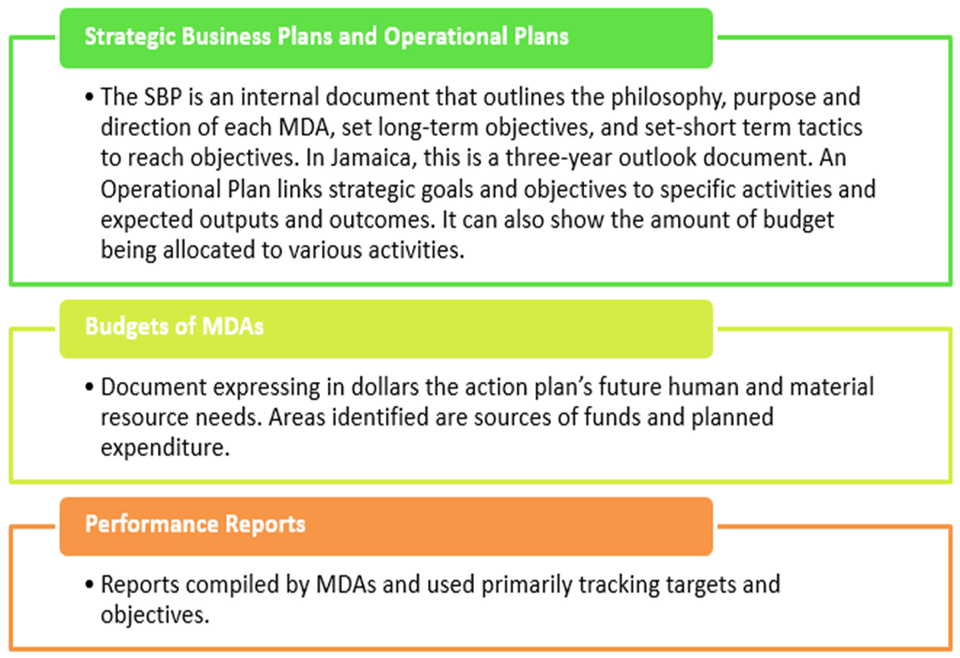

Slide 11
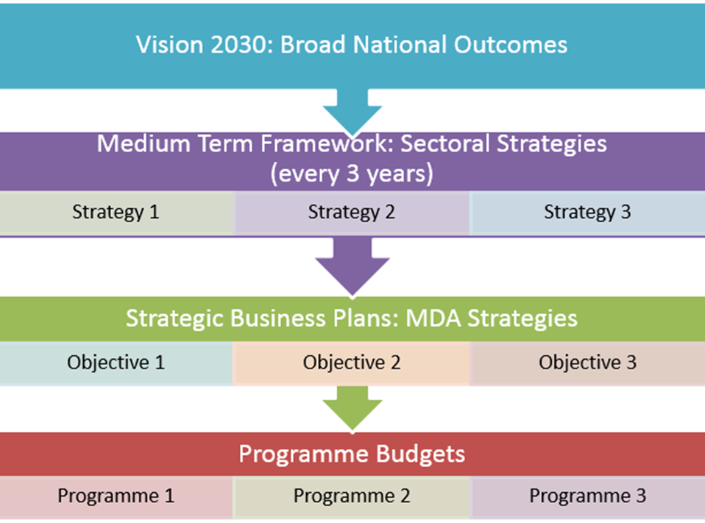
Results Chain Framework - MDAs

Slide 12
Results Chain Framework: Status -MOEYI
Developed and submitted by MOEYI
  Programmes linked to Strategic objectives (19)
  Objectives aligned to MTF National/Sector Strategies
  Linked relevant National Outcome
  Linked relevant National Goal

Slide 13
Budget Programme Rationalisation:
Selected Core Underlying Principles
Programme – coherent grouping of core functions/groups of core services or interventions intended to achieve a common purpose
  Mandate Orientation: Programmes should reflect and translate the ministry’s mandate-what the ministry exists for (e.g. MOEYI Programme- Education and Training Services).
  Coherent Functional Grouping: All functions with the same policy objective must be grouped under a single programme, regardless of revenue source.
  Programme Exclusivity: A programme should not span multiple ministries.
  Sense of Purpose: Programmes must at glance communicate their purposes
  Unique Programme Identification: Programmes must be clearly differentiated from one another both in policy objective and programme name.
  Programme Hierarchy: Programme must precede the sub-programmes.
    Addresses a strategic issue identified by the Govt. (i.e. Higher Education and Training)
    Broad in nature and scope than sub-programme
    Sub-programmes bring the services/goods to the end user
Notes:
Programme – coherent groupings of core functions/group of core services intended to achieve a common purpose

Slide 14
Budget Programme Rationalisation:
Selected Core Underlying Principles
  Programme Classification:
    Support Programmmes – provides operational support to the Service delivery programme
    Service Delivery Programmes – focus on the reason for existence of the ministry, specific to the ministry, represent Core Service Programmes
    No mixing of Support and Service Delivery Programmes/Sub-Programmes
  Programme Naming: Names must easily communicate the purpose. No use of nouns/pronouns etc.
  Programme Number:
    Large ministries should have no more than 5 programmes
      Exception:
        MDAs with complex mandates and large budgets may exceptionally have more than 5 programmes
    MDAs with fewer expenditures or a limited mandate may have fewer programmes

Slide 15
Budget Programme Rationalisation:
Selected Core Underlying Principles
Ten Percent (10%) of the MDA’s expenditure (10% Rule)
  Programmes should not represent less than 10% of the MDA’s expenditure.
    Proper justification is required to do otherwise

Slide 16
Do Programmes Meet Good Practice Criteria?
Criteria | Yes/No
Are all functions of the MDA represented by the programme structure?
Does each programme link to a specific aspect of the overall mandate of the MDA?
Are the programmes mutually exclusive? i.e. no services/functions overlap?
Does the programme relate to a core function or to a subsidiary/non-core function within the MDA?
Can the costs for each programme be separately identified?

Slide 17
Review – Do Programmes Meet Good Practice Criteria? Cont’d
Criteria | Yes/No
Does the programme structure unnecessarily fragment the budget? Can the budget be implemented through the programme structure?
Does each programme represent at least 10% of the MDAs total expenditure?
Is the programme objective or overall purpose unique (or distinct) from other programmes?
Will the programme structure remain stable over time, reflecting the mandate of the MDA?
Does the programme name readily describe what the programme does so that the public will have a sense of its purpose and/or what problems it addresses?
Is programme 1 appropriately named? If it is a standard programme

Slide 18
Developing Programme and Sub-Programme Objectives
Identify the nature or type of services offered under each programme
Identify what ‘needs’ ought to be met by services offered by the programme
Identify what will change by the meeting the needs (The Desired Change).
Formulate an objective from the desired change or what the MDA wish to change by the service or product offering (programme objectives )
Define the desired outcomes of the programme
Define the type of outputs required to produce in order to provide the service and achieve the desired end.
Formulate sub-programme objectives based on the identified outputs (contributing objectives)
Objectives must be clear, cascading and concise
  Programme objective - expression of what the Govt intends to achieve under each programme in terms of addressing a particular situation - must be outcome/result-oriented
  Sub-programme objectives expression of what Govt must produce to contribute towards the achievemnt of the Programme objective - must be output-oriented
Notes:
Inputs – resources used to carrying out of activiities to produce outputs e.g. money, no. employees, salaries, maintenance cost, book costs
Outputs – goods or services provided resulting from the intervention e.g. no. test admin, no. children taught, no school lunches provided
Efficiency – ratio between inputs and the outputs gained from the inputs e.g. cost per school lunch, cost per English test admin., sec student/teacher ratio
Outcomes – changes brought about by govt interventions, expressed as changes upon the programme’s target – indivdls, society at large e.g adult literacy rate, secondary graduation rate

Slide 19
Rationalized Programme Structure: status - MOEYI
Developed and approved
New Programme Structure
  Programmes: 5
  Sub-Programmes: 19
Old Programme Structure
  Programmes: 16
  Sub-Programmes: 48

Slide 20
41000 – MOEYI | PROGRAMMES | SUB-PROGRAMMES
 | Executive Direction and Administration | Central Administration Policy Planning and Development
 | Education and Training Services | Pre-Primary Education Primary Education Secondary Education Higher Education and Training Special Needs Education Services Curriculum Development and Support Teacher Training and Development Student Assessment Regional Educational Support Services
 | Student Support Services | School Nutritional Support Scholarship and awards Student Financial Assistance
 | Public Education and Information | Public Library Services Records and Information Management Communication Information Regulatory Services
 | Child and Youth Development | Youth Development Services Child Development Services

Slide 21
Programme/Sub-Programme Descriptions and Objectives: status - MOEYI
Developed and submitted – review in progress
  Timeline omitted in most cases e.g. Institutional governance and operational capacity of the MDA enhanced by 2023 or over medium term
  Programme - Description missing 1or 2
  Objectives for Child Development Services – duplication with CPFSA? Is ministry role one of oversight?
  Support Service existing under Service Delivery Programme e.g. Communication under Public Education and Information, needs to be examined
  Re-wording of some objectives/descriptions.
  Need to exclude ‘strategies’ from objectives- To increase access to special education support for children at risk through public education, needs based intervention and programmes for their safety, security, growth and development

Slide 22
Performance Management
Performance Management involves
  measuring performance against targets set in the budget
  programme evaluation
Key Performance Indicators (KPIs) -at the core of MTRBB
4 categories of indicators (for budget)–
  Input
  output
  efficiency
  outcome
Notes:
Inputs – resources used to carrying out of activiities to produce outputs e.g. money, no. employees, salaries, maintenance cost, book costs
Outputs – goods or services provided resulting from the intervention e.g. no. test admin, no. children taught, no school lunches provided
Efficiency – ratio between inputs and the outputs gained from the inputs e.g. cost per school lunch, cost per English test admin., sec student/teacher ratio
Outcomes – changes brought about by govt interventions, expressed as changes upon the programme’s target – indivdls, society at large e.g adult literacy rate, secondary graduation rate

Slide 23
Purpose of Performance Indicators in MTRBB
    Performance indicators in MTRBB are intended to show progress towards addressing the strategic priorities over time
    They are linked to the strategy priority areas that the MDA will focus on over the next 3 years/medium term
    These areas show where the MDA wants to improve the quality or scope of its services, performance indicators show progress towards these priority objectives
    Stakeholders (Parliament, Public, MOFPS etc.) will track policy performance against budget allocations, decision making, scrutiny of budget, state of the public services and its progression overtime

Slide 24
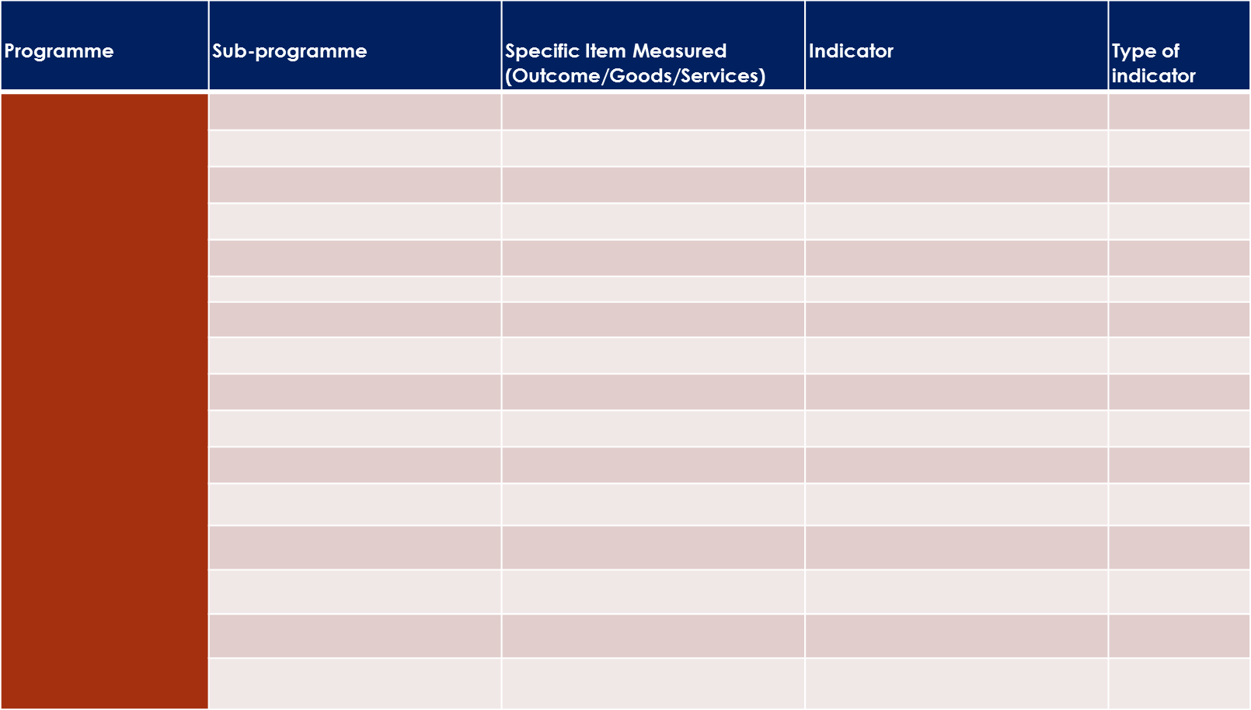
Performance Information Identification Matrix-template 1

Slide 25
Key Performance Information Table/Template- 2
National Goal:
National Outcome:
Sector Outcome:
MDA Strategic Objective:
Programme Name & Ref:
Programme Objectives:
Performance Indicator | Unit of Measure | Functional Agency/Dept./ Division | FY18-19 Base Year (Past/Actual) | FY19-20 Projected Outturn | FY20-21 Estimates (Current) | FY21-22 Projected (Forecast) | FY22-23 Projected (Forecast) | FY23-24 Projected (Forecast)
Inputs:
Outputs:
Efficiency:
Outcomes:

Slide 26
Education and Training Services |  | Outcome: Improved students performance at the different levels of the system | % of students exiting the system ready for the world of work and or further education… | Outcome
 | 2.1 Early Childhood Education | Service: Equity and access to high quality education | # of students accessing high quality differentiated programme … | Output
 | 2.2 Primary Education | Service: Equity and access to high quality education provided | # of students accessing high quality differentiated programme … | Output
 |  | Outcome: Increased literacy and numeracy rates at the grade 4 level | % increase in literacy and numeracy rates… | Output
 |  | Outcome: Improved student performance on national examinations at the grade 6 level | % increase in the number of students attaining proficiency and high Proficiency in all subjects at Grade 6 level… | Output
 | 2.3 Secondary Education | Outcome: Improved student performance on national examinations up to the secondary level | % increase in the number of students passing at least five subjects at the secondary level | Output
 | 2.4 Higher Education and Training | Outcome: Increased percentage of programmes at the tertiary level that meet established standards of quality | % increase in the number of tertiary level programmes that meet established standards | Output
 | 2.5 Needs Special Services | Outcome: Increased access to special education support for children at risk through public education, needs based intervention and programmes for their safety, security, growth and development | % increase in access to special education support for at risk children | Output
 |  |  | # of children benefitting from special education programmes | Output
 | 2.6 Curriculum Development and Support | Outcome: Improved relevance of curriculum offerings at all levels of the education system. | # of relevant curriculum offerings | Output
 | 2.7 Student Assessment | Outcome: Improved assessment framework for pre- primary, primary and secondary levels of the education system | Assessment framework in place that meet established standards at the respective levels | Output
 | 2.8 Teacher Training and Development | Outcome: Sustained quality of practice promoted in advancing the teaching profession | % of teachers having the required qualification for working in the sector | Output
 |  |  | # of in-service teacher benefitting from programmes | Output
 | 2.9 Regional Educational Support | Service: Quality of educational services at the Regional level | % increase in the number of satisfied stakeholders at the regional level | Output
 |  |  | Services provided which meets prescribe standards | Output

Slide 27
National Goal: | Jamaicans are empowered to achieve their fullest potential
National Outcome: | World-Class Education and Training
Sector Outcome:
MDA Strategic Objective: | 2. To maximize the percentage of Jamaican children ages birth - 3 years who have access quality care and stimulation. 3. To maximize the percentage of Jamaican children ages 3-18 who have access and/or attachment to a high quality education and training. 4. To maximize the percentage of Jamaican youth ages 15-29 who have access to opportunities for continuing education and training. 5. To maximize the percentage of the work force that is trained and certified to satisfy labour market demands. 6. To maximize the percentage of Jamaican educational programmes that meet prescribed standards of quality 8. (a) To maximize the literacy rate; (b) To maximize the numeracy rate. 9. To maximize the percentage of Jamaican students and teachers who have access to a safe and secure, physical, social, emotional and spiritual environment in which to learn and work.
Programme Name | Education and Training Services (2)
Programme Objectives: | Quality of education and training improved by 2023
 | 2. Access to education and training increased by 2023
Performance Indicator | Unit of Measure | Functional Agency/Dept./ Division | FY18-19 Base Year (Past/Actual) | FY19-20 Projected Outturn | FY20-21 Estimates (Current) | FY21-22 Projected (Forecast) | FY22-23 Projected (Forecast) | FY23-24 Projected (Forecast)
Inputs:
Outputs:
Students accessing high quality differentiated programme at Pre-Primary level | # | DSS
Students accessing high quality differentiated programme at Primary level | # | DSS
Efficiency:
Outcomes:
Increase in literacy and numeracy rates | % | DSS
Increase in the number of students attaining proficiency and high Proficiency in all subjects at Grade 6 level | % | DSS
Increase in the number of students passing at least five subjects at the secondary level | % | DSS
Increase in the number of tertiary level programmes that meet established standards | % | DSS

Slide 28
Key Performance Information: status - MOEYI
Identification Matrix (template 1)- completed by ministry, review in progress
Key Performance Indicators (KPIs) (template 2) incomplete information, all data missing
  Baseline, projections, performance targets, input indicators, outcome indicators (some programmes), key assumptions, risks, etc.
  Submission - August 23

Slide 29
Next Steps:
  Submission of outstanding information (MOEYI_ completed KPIs table)
  New Rationalized Programme Structure and KPIs in Budget Preparation and Management System (BPMS).
  MDAs Budget Request/Estimates of Expenditure: Rationalized Programme Structure, KPIs (with key assumptions and risks for each Programme) Results Frame-work
  Budget Call: circular/financial instructions– MDAs audited
    Website: circular, budget request, budget approved
  Monitoring and tracking results, updating of KPI template/database
  Evaluate Programme performance
  Reporting, Performance audits

Slide 30
Way forward:
  Develop more realistic and credible budgets
  With proper performance management – more efficient service delivery – value for money
  Performance impact strategic objectives/National outcomes
    Better Budgeting…Better Results

Slide 31
THE END

