Slide 1

MOEYI
Budget Unit

Slide 2
Overview
The Budget Unit provides Financial and Accounting Services to support the ministry’s mandate through the preparation of the annual recurrent budget and annual cash flow.

Slide 3
Responsibilities
Analyzed budgets received from agencies, institutions, schools and departmental heads in accordance with the ministry’s strategic and operational plan.
Budgets are then compiled in a single document in the Budget Preparation Management System (BPMS) and submit to the Ministry of Finance and the Public Service.

Slide 4
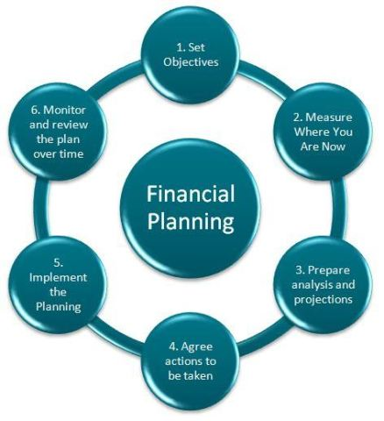
Budget Process

Slide 5
Types Of Planning
Strategic Planning
Process of defining the organization strategy direction and long term goals.
Operational Planning
Describes how the strategic plans will be achieved during a specified operational period.

Slide 6
GOJ Planning and Budget Cycle
The integrated financial cycle is :
Policy
Planning
Budgeting
Procurement
Monitoring and Evaluation

Slide 7
Benefits of Planning
Reduce Risk
Establish Priorities
Facilitates Coordination
Aids in the organisation to resources
Supports the evaluation of performance

Slide 8
What is Zero – Base Budgeting ?
Zero based budgeting is an approach that develops the budget from scratch ,or from a “zero base” , by examining every cost and expenditure to ensure they are essential to the strategic goals and operational priorities,
without regard to the prior years’ activities

Slide 9
Implementing Zero Based Budgeting
In practice ZBB is more than simply a budgeting process. ZBB is a management tool that effectively links the planning, Budgeting and control process to produce meaningful operational plans and monitoring procedures.

Slide 10
Aligning Planning with ZBB
What
strategies and tasks that must be
undertaken
Who
persons who have responsibility for
each of the strategies/tasks
When
timelines in which strategies/tasks
must be completed

Slide 11
Aligning planning with ZBB (contd)
How much :
amount of financial resources provided to complete each strategy / task

Slide 12
ZBB Mindset
Does : require tight alignment with the planning process and the organisation’s priorities
Does : require complete cost justifications during the budgeting period
Does : link the justification of the priorities with cost to value (alternatives)

Slide 13
QUOTE
“Great things in business are never done by one person. They are done by a team of people”
projectmanager.com

Slide 14


