Slide 1
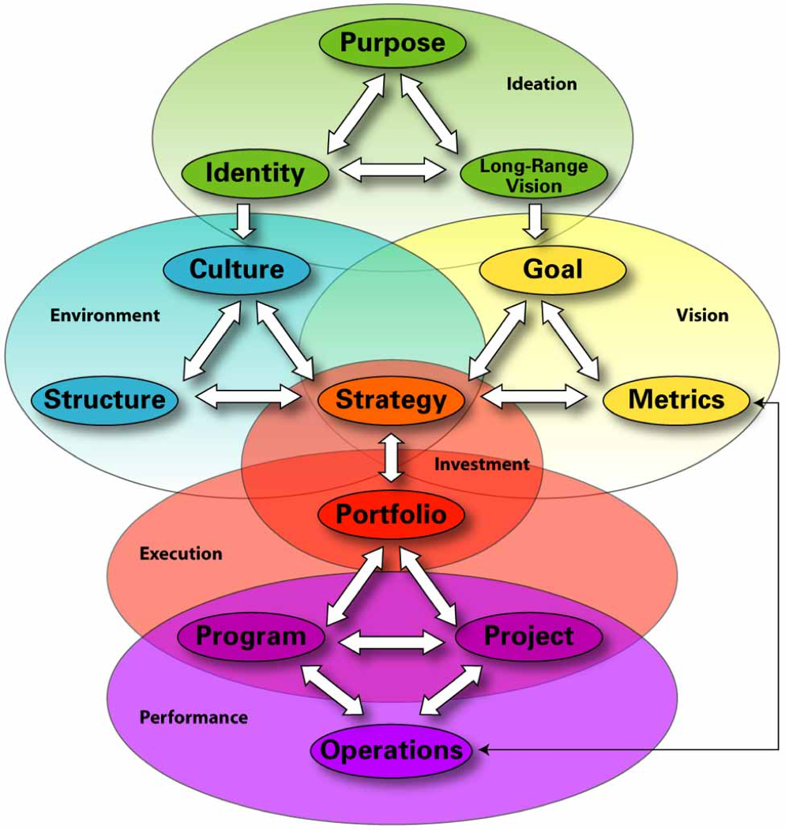
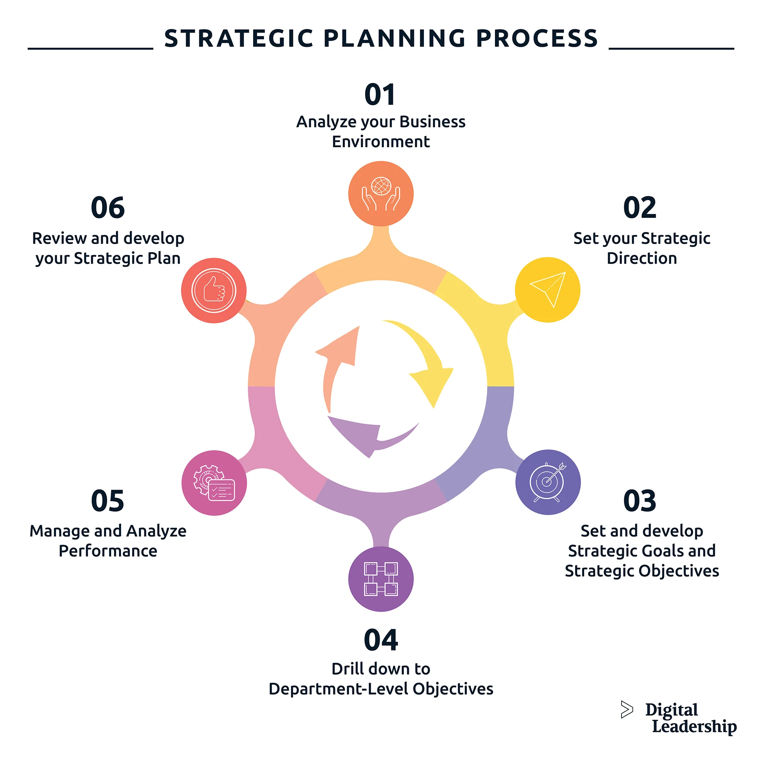
Results Based Strategic Planning
Strategic and Operational Plans
Strategic Planning Framework
It is important to distinguish between Strategic Planning and Planning Processes and a Strategic Planning Framework.

Slide 2
Re-Sensitization of the
Corporate Planners Network (CPN)
Ministry of Education
"Steps to Build and Maintain a Results-Based Strategic/Operational Plan & Framework".
Presented by: Craig F Barham, PhD
30 October, 2023

Slide 3
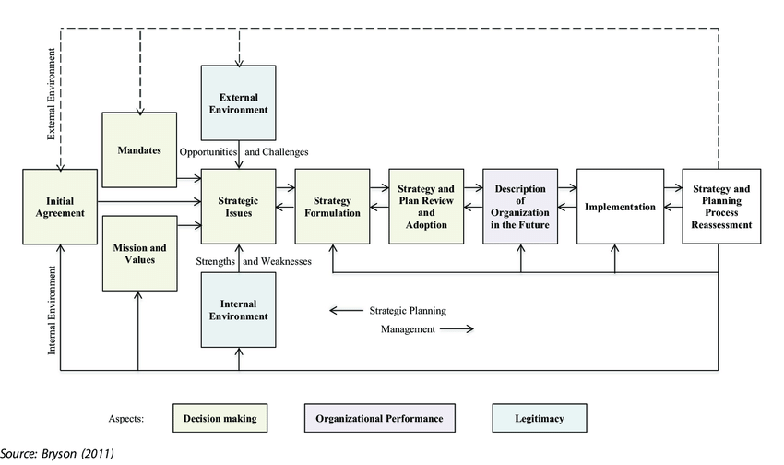

Slide 4
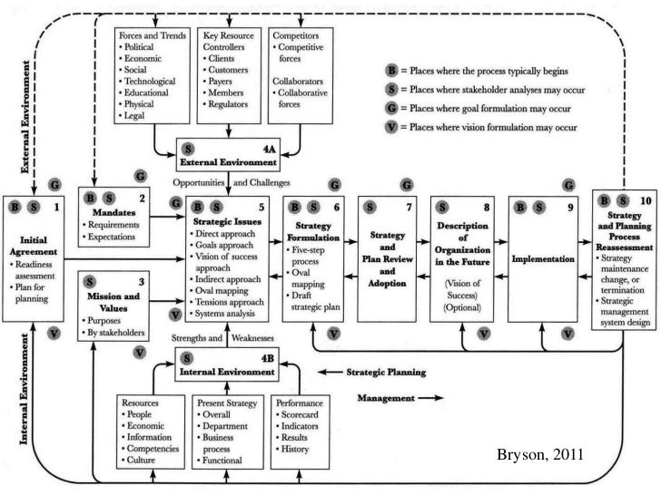
Strategic Plan
Review
Evaluation
Operational Plan
Implementation
Monitoring

Slide 5
Building and Sustaining a
Strategic Planning Framework
Build a Culture that is aligned with performance management.
Create Demand for information/evidence to support decision making.
Set clear Roles, Responsibilities and Expectations among stakeholders.
Build technical Capacity to produce trustworthy and credible information to establish baselines and develop targets and indicators.
Build Governance framework to ensure transparency and accountability.
Build general Capacity to understand the planning process and use the information to make better decisions.
Sustain with the correct Incentives.

Slide 6
Building and Sustaining a
Strategic Planning Framework
The IRBM system is made up of 5 key components.
There are 2 primary components and 3 complementary components.
The primary components are:
  Results Based Budgeting System (RBB), and
  Results Based Personnel Performance System (PPS)
While the 3 complementary components are:
  Results Based Management Information System (MIS),
  Results Based Monitoring and Evaluation Framework (M&E).
  E-Government (EG) system.

